Slide 1
Arduino Workshop
Session 1

Slide 2
At first, Let me know what do you expect from this workshop?

Slide 3

GENIUS!

Slide 4
Workshop Outlines
Arduino IDE
Programming basics
Basics of electrical/electronics circuits
Sensors
Motors & motor dives
Wireless control
LCD

Slide 5
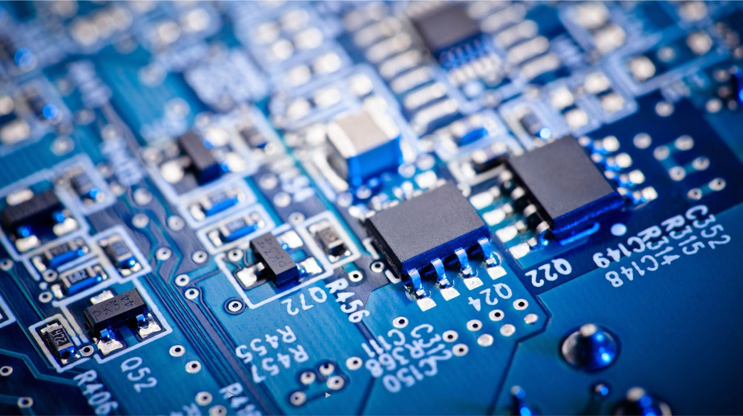
Embedded Systems

Slide 6
Embedded Systems
An embedded system is a system that includes hardware and software combination to reach a specific target.
For example:
Camera , iPod, older types of mobile phones, Arduino ..etc

Slide 7
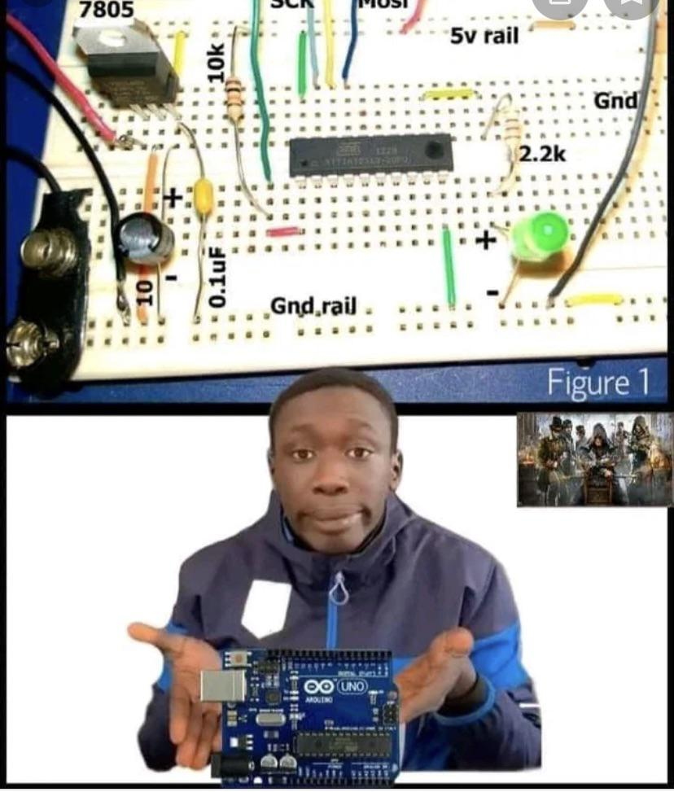
Embedded Systems
Why do we need embedded systems?
Before embedded systems all the circuits designed were fixed.
After microcontrollers now you can have unlimited no. of changes on circuits without soldering or any changes on circuit configuration.

Slide 8
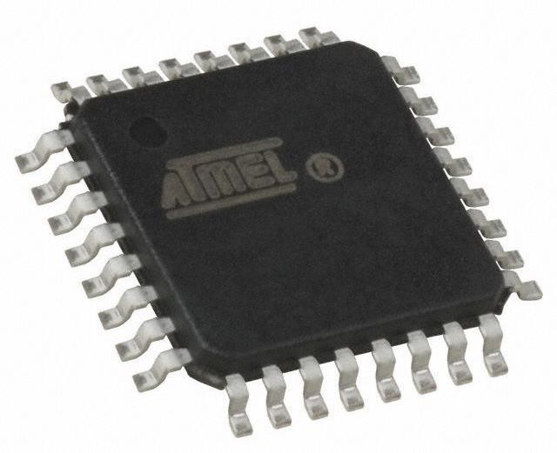
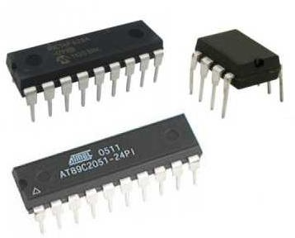
Embedded Systems
Microcontrollers
Simply it’s like a processor with a built-in RAM.

Slide 9
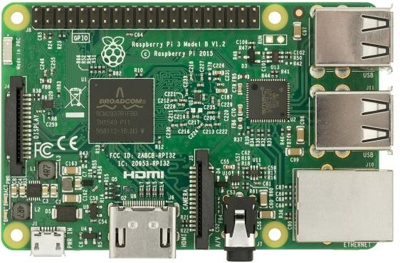
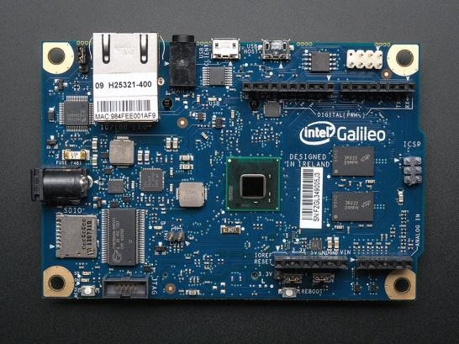
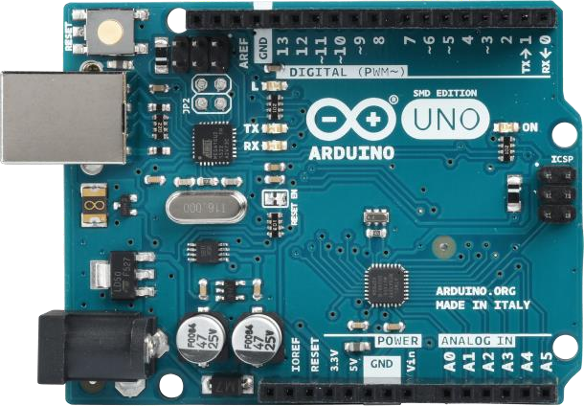
Embedded Systems
Chips based on Microcontroller:
Raspberry Pi
Galileo
Arduino

Slide 10
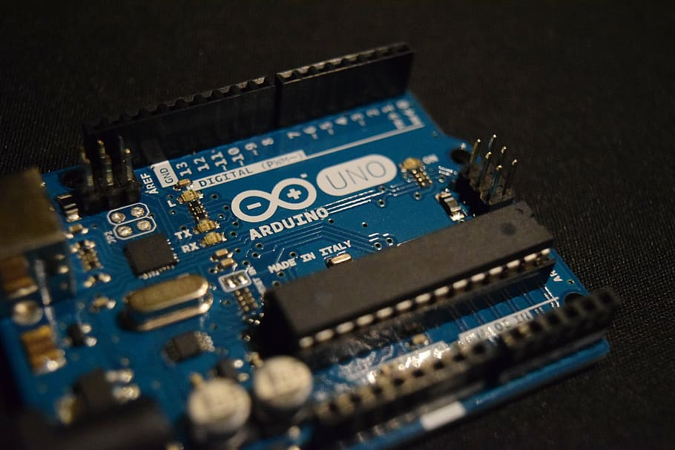
Arduino Uno

Slide 11
















Open source
software
Open Source Hardware
Suitable for
Windows, Linux and Mac OS
inexpensive
Arduino
simple
support

Slide 12
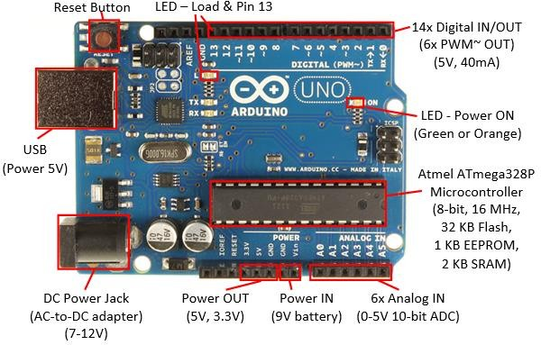
What’s on the UNO board?

Slide 13
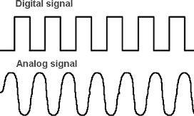
Digital Signal
A Digital Signal on the Arduino can be only in two states: HIGH or LOW.
This is true whether the digital signal is an input or an output. When a pin is at 5v it is considered HIGH, and when it is at 0v or GND, it is considered LOW.

Slide 14
Digital Inputs
Note: Sometimes a Digital Input Signal might not always have a full 5v available, so the threshold to drive an input pin HIGH is around 3v, and anything below this threshold is considered to be LOW.
And that’s why Analog i/o is more accurate.

Slide 15
Analog Signal
We have established that a digital I/O signal must either be LOW (0v) or HIGH (5v).
Analog voltages can be anywhere in between (2v, 3.4v, 4.6v, etc.)

Slide 16
Why should we convert A to D?
There is no device that can produce an accurate analog signal.
As it needs a tends-to-infinity size of memory
So, we convert it to a close enough digital signal

Slide 17
Analog OUTPUT (PWM)
This is not technically an analog output, but it is the digital equivalent to an analog voltage available at an output pin.
This feature is called ‘Pulse Width Modulation’, and is an efficient way of delivering a voltage level that is somewhere between the Source and GND.

Slide 18
Analog and Digital i/o functions
Analog
Digital
Analog INPUT
analogRead ( Pin number );
Ex: analogRead ( A0 );
Analog OUTPUT
analogWrite (PWM pin number, 0→255);
Ex: analogWrite ( 3, 125 );
Digital INPUT
digitalRead ( Pin number );
Ex: digitalRead ( 2 );
Digital OUTPUT
digitalWrite ( Pin number , HIGH or LOW );
Ex: digitalWrite ( 4 , LOW );

Slide 19
Other important Functions:
pinMode
pinMode(Pin number, INPUT or OUTPUT);
Ex : pinMode(2,INPUT);
delay
delay(time in ms);
The Arduino changes nothing for that while

Slide 20
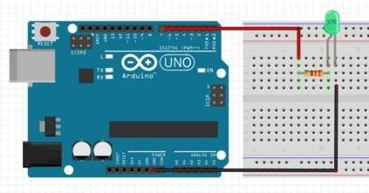
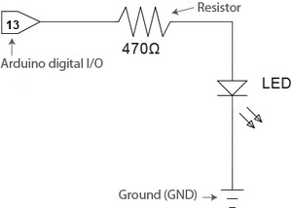
1st project: Blinking an LED:
Simulator

Slide 21

Coding Principles

Slide 22
If statement
if ( condition is true)
{
do something;
}
else if (another condition is true)
{
do something else;
}
else
{
do something else;
}

Slide 23
while loop
do
{
something;
}
while ( condition is true);
while ( condition is true)
{
do something;
}

Slide 24
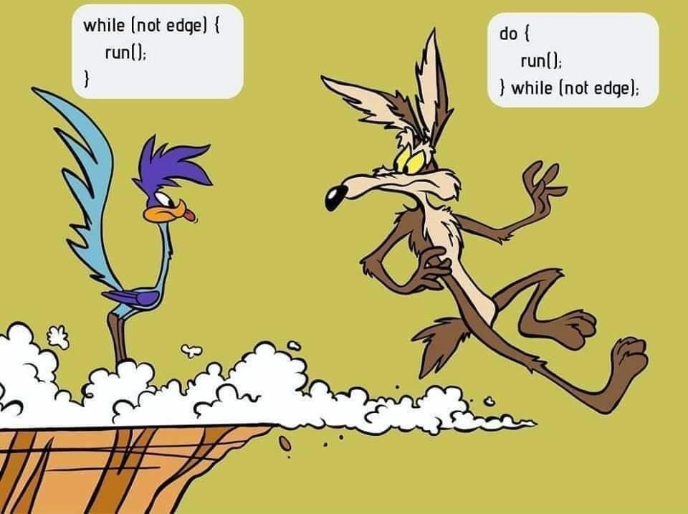
while VS do.. while

Slide 25
For loop
for( counter initial value ; repeat the loop while ; counter increment/decrement)
{
// what to do in each loop/time ;
}
Example:
for( int counter = 0 ; counter < 5 ; counter = counter + 1)
{
// what to do in each loop/time ;
}

Slide 26
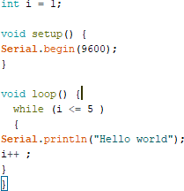
Serial monitor:
Used to print output to the user

Slide 27
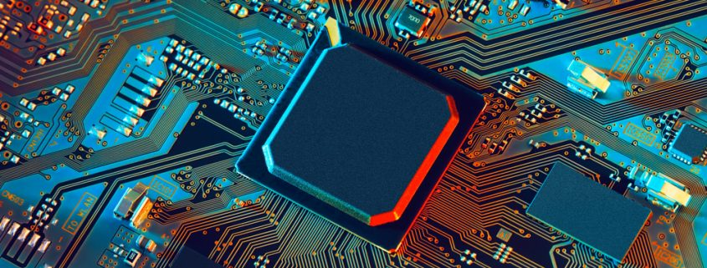
Interfacing

Slide 28
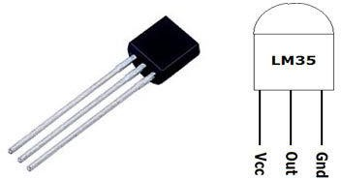
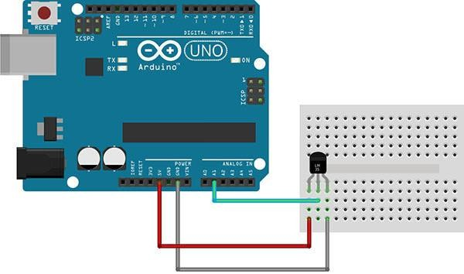
Temperature sensor
LM35 sensor
Circuit

Slide 29
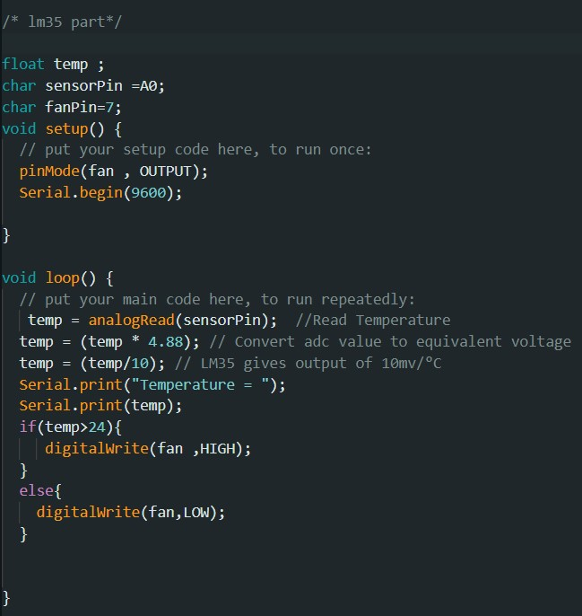
Application:
Automatically Controlling
air-conditioning system

Slide 30
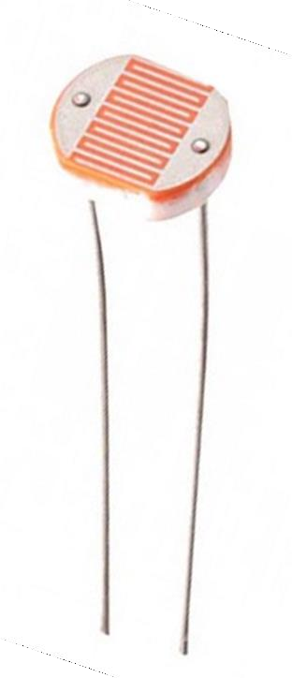
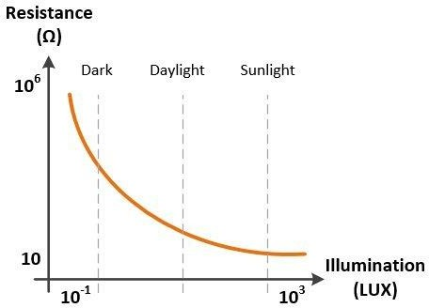
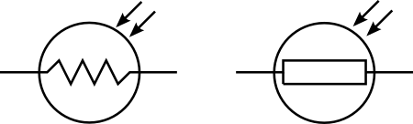
Light sensor
LDR = Light Dependent resistance
Also known as: Photo resistor = photo cell

Slide 31
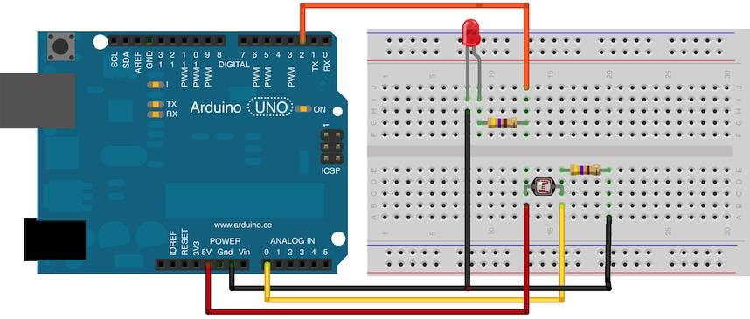
Light sensor
Circuit:

Slide 32
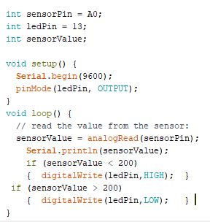
Light sensor
Code:

Slide 33
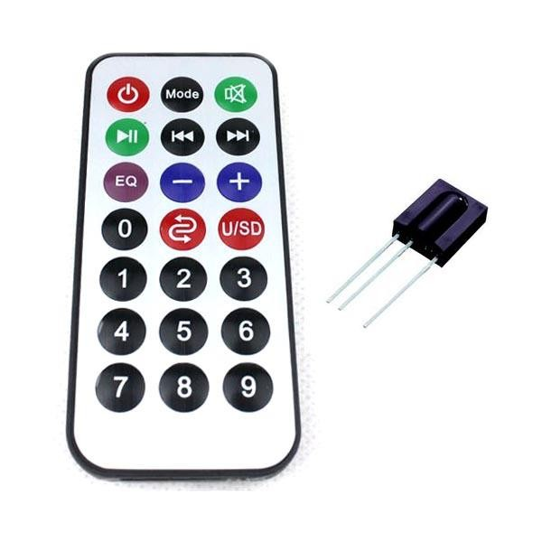
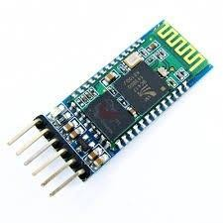
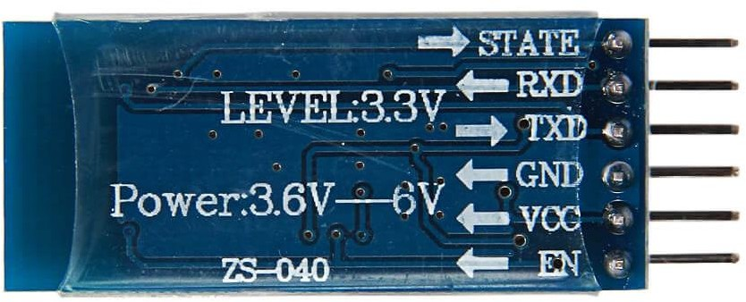
WIRELESS CONTROL
1- remote controller
2- Bluetooth module

Slide 34
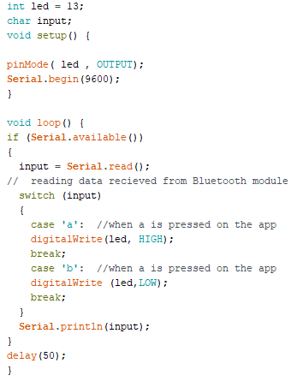
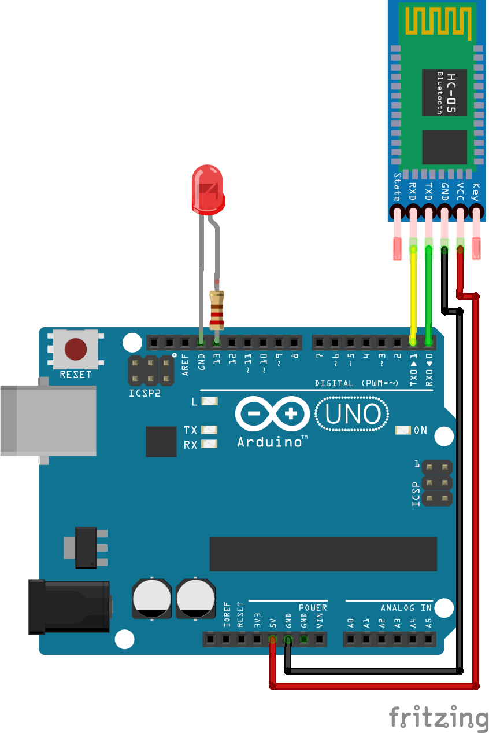
Bluetooth module
Switching led using your phone

Slide 35
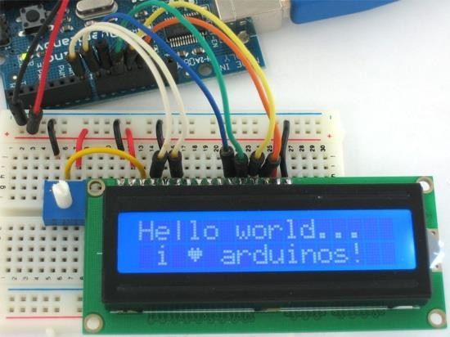
LCD
Liquid Crystal Display:

Slide 36
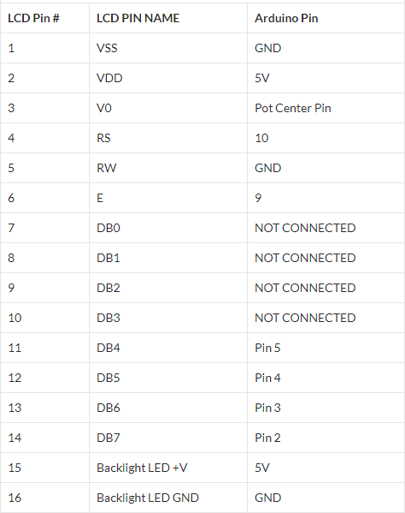
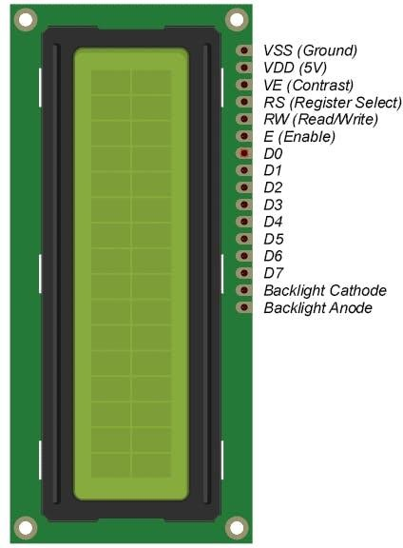
LCD

Slide 37
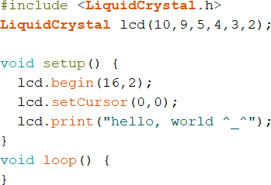
LCD
Note:
lcd(rs,e,d4,d5,d6,d7)

Slide 38
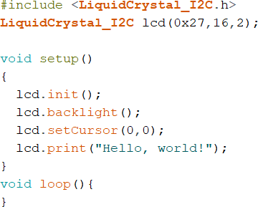
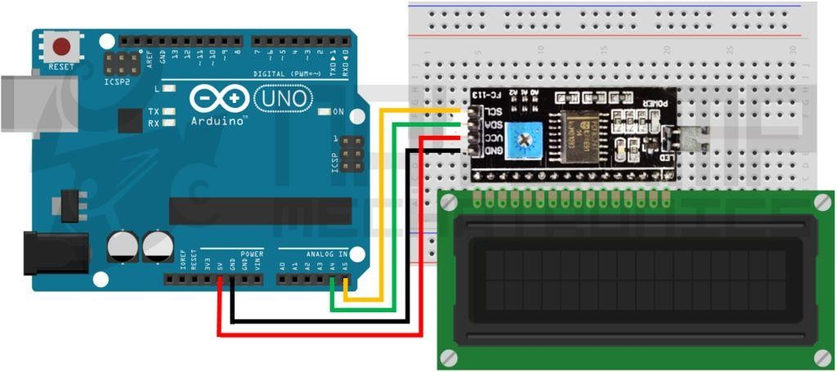
LCD with I2C:

Slide 39
Any Questions..?

Slide 40
Thank You

